Slide 1
Improved Expert Search
Z
M
S
Z
M
S
Team ZMS (Zacharia Rupp, Mriganka Sarma, Sai Ranganathan)

Slide 2
Introduction
Z
M
S
What is ExpertSearch System
The System As It Is

Slide 3
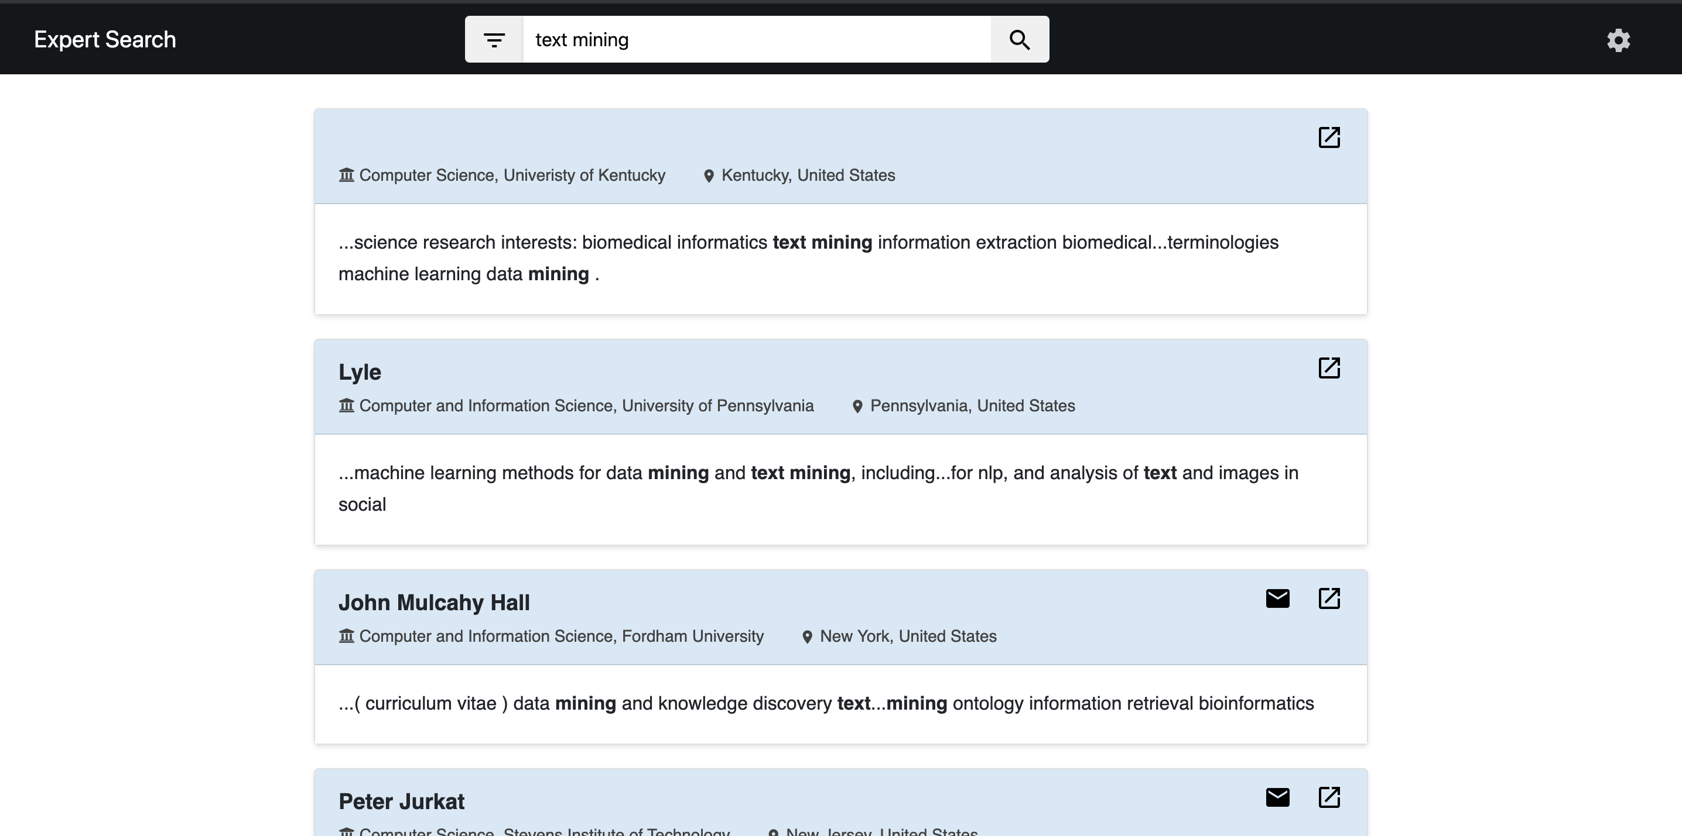
The System As It Is
Z
M
S

Slide 4
Challenges of Current System
Z
M
S
Manual Process for Directory URL Identification
Manual Process for Faculty Webpage Identification
Need for Structuring of Faculty Information
Need for Improved Extraction Methods

Slide 5
Proposed Improvements
Z
M
S
Automatic Scraping of Faculty Directory and Faculty Webpages
Mining Top Research Topics of Faculty
Improved Email Extraction
Improved UI for Better Visualization of Structured Data

Slide 6
Setup Instructions
Z
M
S
Clone the project repository
$ git clone https://github.com/sairanga123/CourseProject.git
Create Anaconda python 2.7 environment
Install python packages
gensim
nltk
gunicorn
bs4
metapy

Slide 7
Usage Instructions
Z
M
S
Main Functional Categories:
Automatic Scraping
Topic Mining
Faculty Search in UI

Slide 8
Usage Instructions (contd.)
Z
M
S
Automatic Scraping
$ cd ExpertSearch/AutoScraper
$ python ./auto_scraper.py –d –t

Slide 9
Usage Instructions (contd.)
Z
M
S
Topic Miner
Work in jupyter notebook (ExpertSearch/data/expertsearch/LDATopicModeling.ipynb)
Build corpus and dictionary, and create topic model
Manually inspect topics with high coherence
Check against known document
Save best topic model, corpus, dictionary
server.py accesses model with miner.py

Slide 10
Usage Instructions (contd.)
Z
M
S
Email Extraction
$ cd ExpertSearch/extraction
$ python extract_email.py
Different Email Formats To Cover:
Eugene dot agichten at emory dot edu
Rohini [@] buffalo [DOT] edu

Slide 11
Usage Instructions (contd.)
Z
M
S
Running the Backend Server
$ gunicorn server:app -b 127.0.0.1:8095
Running Faculty Search from the UI
localhost:8095

Slide 12
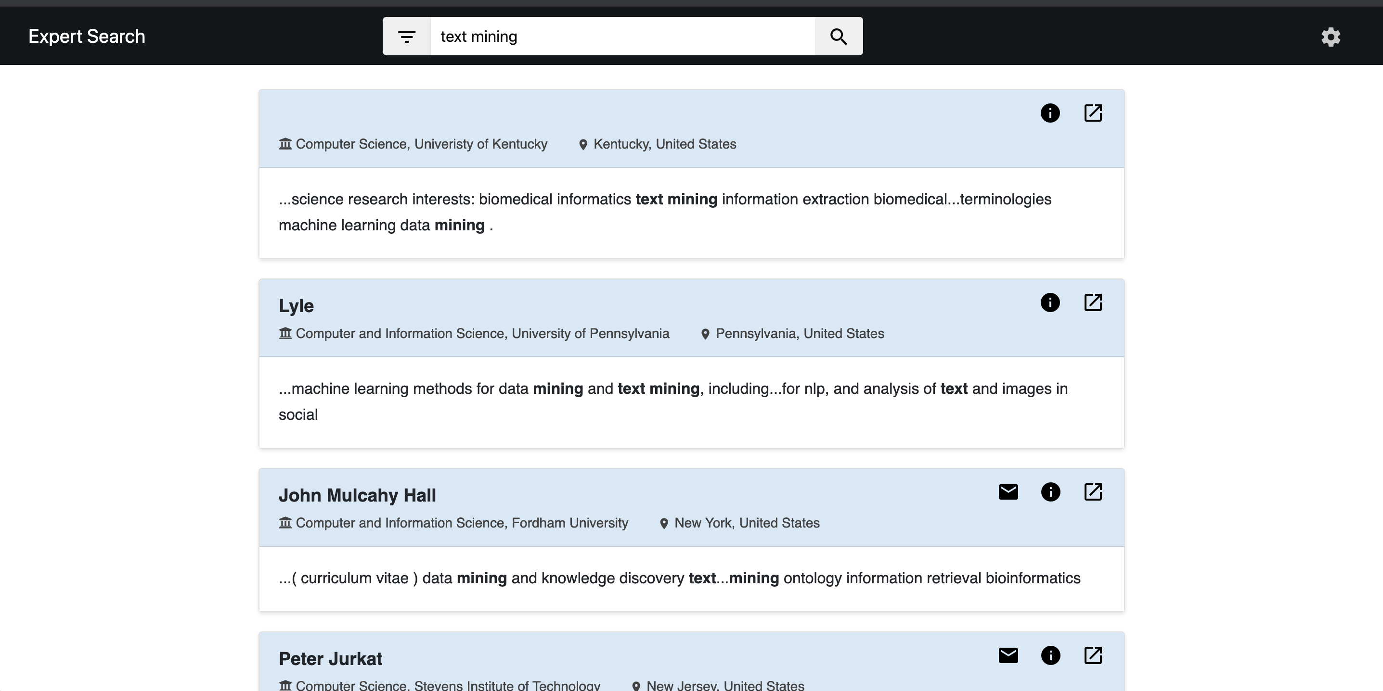
Example Usage
Z
M
S

Slide 13
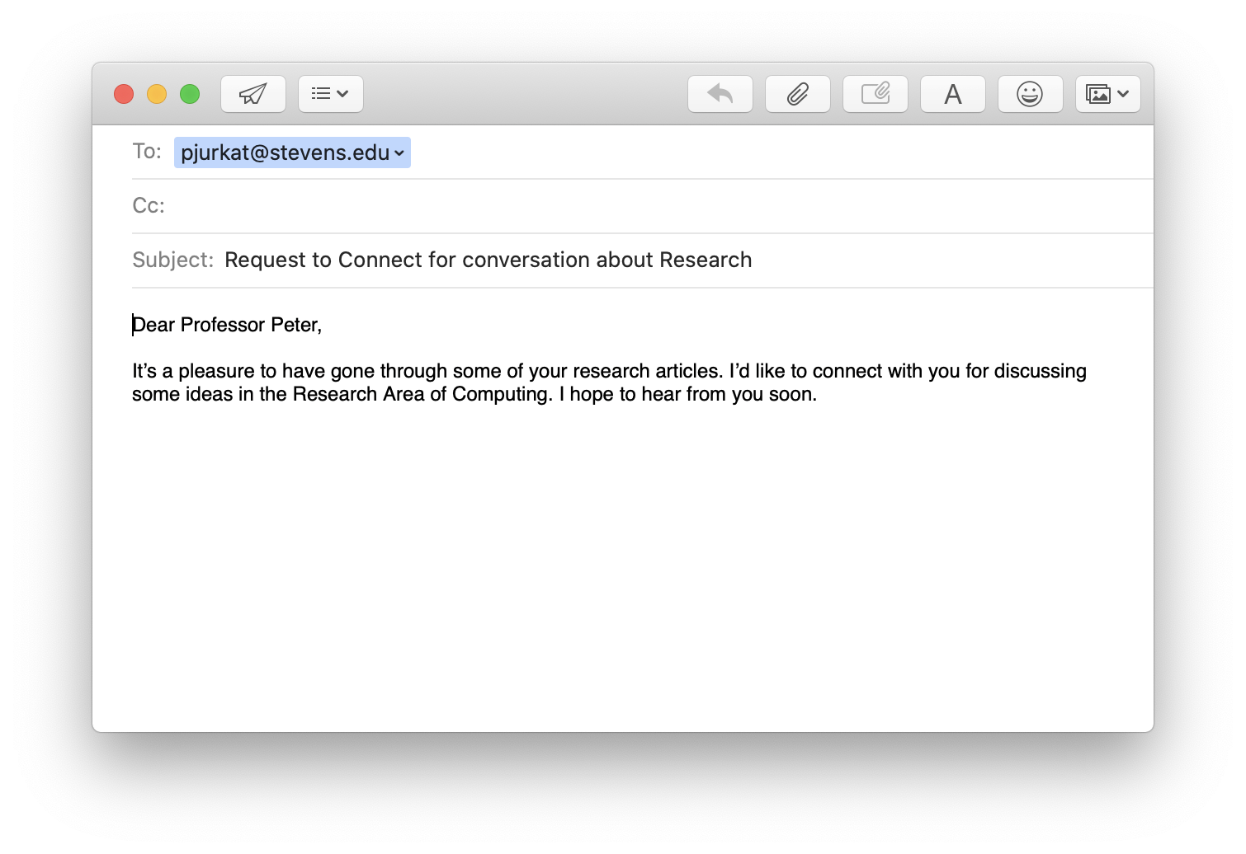
Example Usage (contd.)
Z
M
S

Slide 14
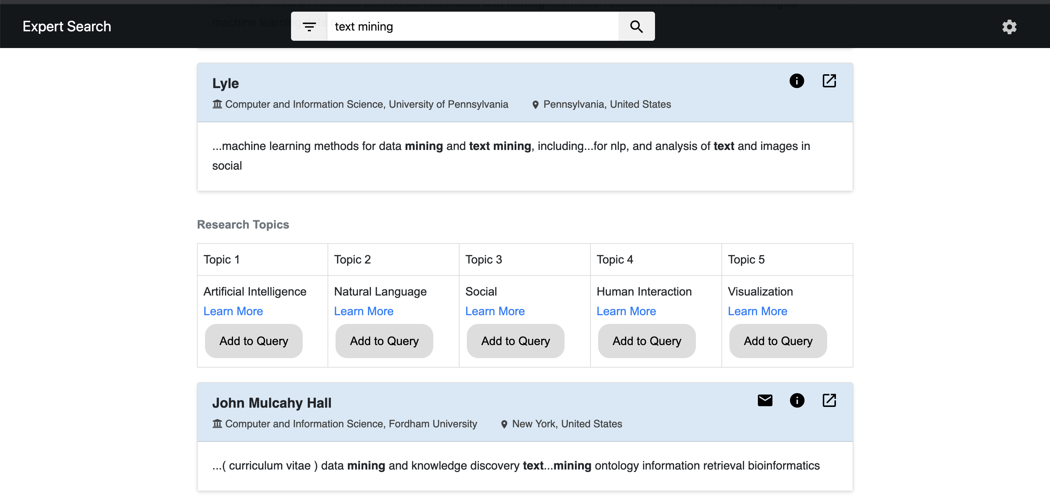
Example Usage (contd.)
Z
M
S

Slide 15
Thank You
Z
M
S
Z
M
S

